Slide 1
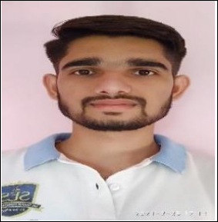
Bhupesh Ramkrishna chaudhari
Analyst / Software Engineer
KEY COMPETENCIES
EXPERIENCE
  Application Managed Services
  Software Development
  Quality & Testing
  Communication
  CAST
    Managed Dashboard Deployment to show code scan result
    Technical details update on Cast Portal
    Serial Action Plan Activity (Monthly)
    Troom Uploads (Monthly)
PROFILE
EDUCATION
  Bhupesh Ramkrishna Chaudhari is a Analyst / Software Engineer at Capgemini with over one year of Information Technology experience.
  Since joining Capgemini in 2021, Bhupesh has excelled in CAST assignment in application code quality testing programs, CAST Tracker Development.
  B. Tech Electronics and Telecommunication Engineering, University of DBATU, Lonere, India
CERTIFICATIONS
Python
AZ-900 Microsoft Azure Fundamentals

